Slide 1

The Future Syntax: Trends Redefining Programming Languages
Gabriel Burlacu March 2024

Slide 2
outline
Summary
Introduction
Methodology
Results:
Visualizations &
Dashboard
Discussion:
Findings & implications
Conclusion
Appendix

Slide 3
Summary
The 2019 Stack Overflow Developer Survey showcases popular programming and database languages, trends, demographics, and preferred platforms among developers. This information is essential for industry decision-making and innovation

Slide 4
Introduction
The Stack Overflow Developer Survey serves as a comprehensive resource, offering insights into developers preferences and behaviors
Key areas covered include the most popular programming languages, database languages, current trends, demographics, preferred platforms, and anticipated future skills
This presentation will explore the 2019 survey findings, providing a snapshot of the global developer community and its implications for the future of software development

Slide 5
Methodology
Data Collection: Utilized the Stack Overflow Developer Survey 2019. Survey conducted online, gathering responses from developers globally. Data obtained in structured formats like CSV files
Data Wrangling: Cleaned data by addressing missing values, duplicates, and standardizing formats. Selected relevant columns for analysis based on research objectives. Applied data transformation techniques as necessary
Data Visualization: Created visualizations using libraries like Matplotlib, Seaborn, and Cognos. Employed various charts and graphs to present findings clearly. Selected visualization techniques based on data nature and research questions. This methodology enabled effective collection, cleaning, and visualization of data

Slide 6
Results
Top 10 programming languages in high demand and usage
Top 10 database languages in high demand and usage
Preferred platforms at present
Current preferred web frameworks
Top 10 anticipated programming languages for the next year.
Top 10 anticipated database languages for the next year
Anticipated platforms for the next year
Anticipated web frameworks for the next year
Respondents classified by gender
Respondents classified by country
Respondents classified by age
Respondents classified by Education/Gender

Slide 7
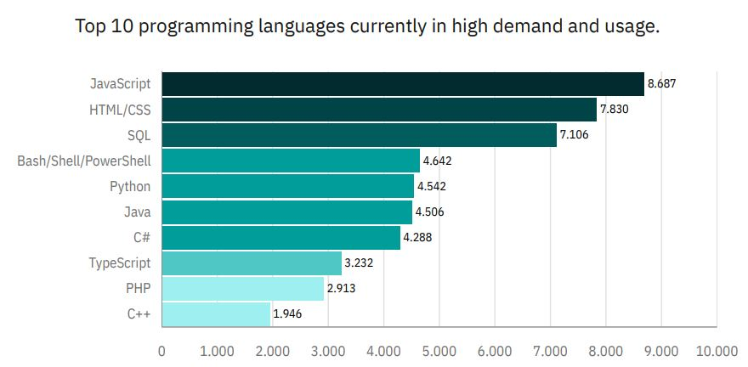
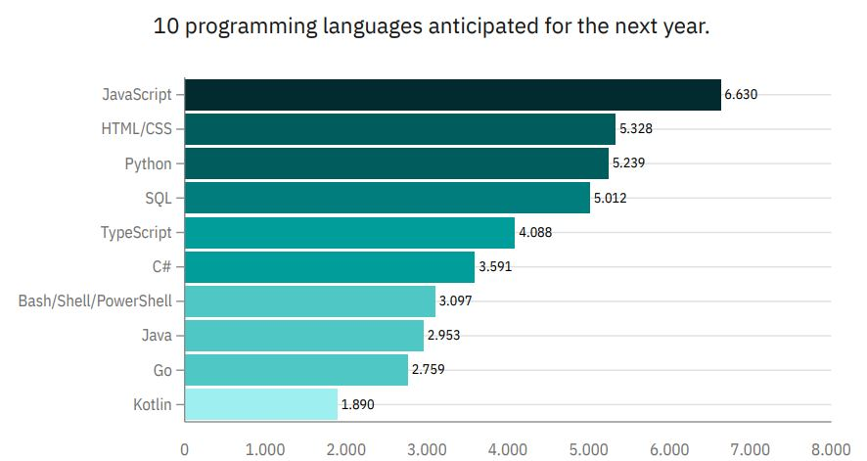
Programming language trend

Slide 8
Programming language trends, findings & implications
Findings:
Javascript, HTML/CSS are the most used and anticipated languages
SQL, as a database language, remains and will continue to be one of the most essential skills
Interest in Python and TypeScript is soaring, while the future of C++, PHP, C#, and Bash appears to be in decline
Implications:
Web development languages continue to dominate and are expected to maintain their prominence
There's a potential trend of JavaScript users migrating towards TypeScript
Python is rapidly emerging as one of the most critical languages in the programming landscape

Slide 9
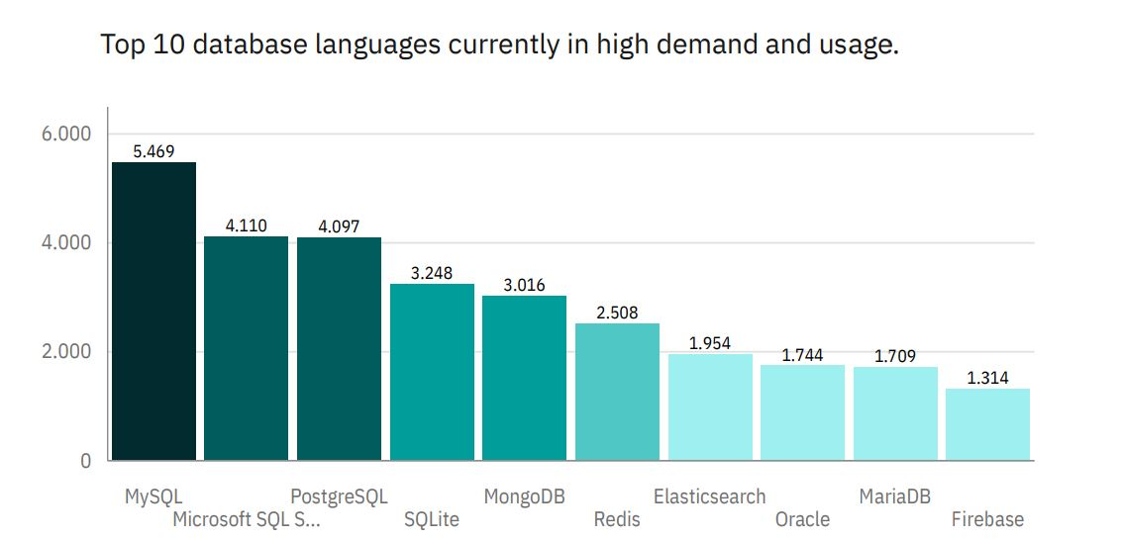
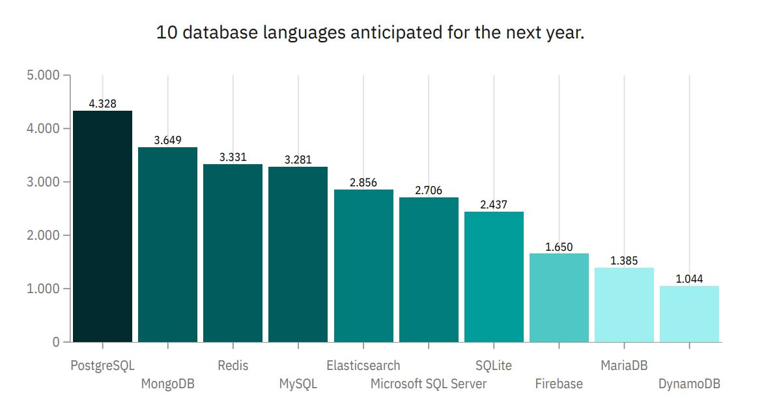
Database trends

Slide 10
Database trends, finding & implications
Findings
SQL database software remains the most popular choice among developers, with MySQL being the favored option
Increasing interest in PostgresSQL and MongoDB
Emerging database technologies such as MongoDB, Redis, and Elasticsearch are quickly gaining popularity
Implications
The traditional dominance of SQL database languages appears to be making room for emerging software solutions
The emerging database languages are predicted to dominate in the near future
PostgreSQL shares similarities with traditional SQL, making it a valuable skill for aspiring data analysts to consider mastering

Slide 11
Link to github display dashboard.
Full dashboard display link.
(CTRL+Click)

Slide 12
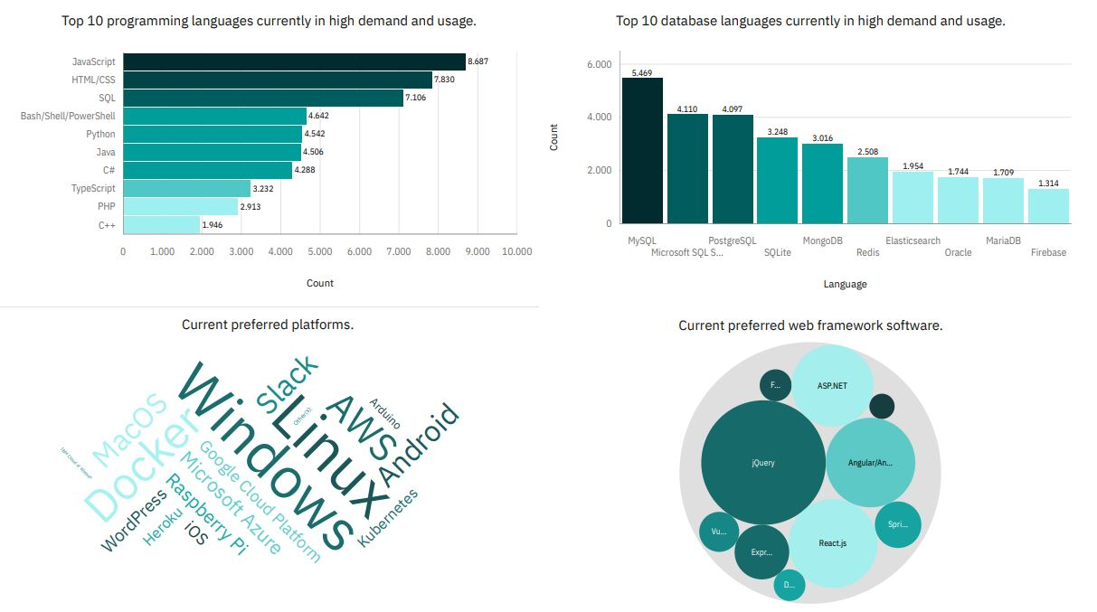
Current Technology Trend

Slide 13
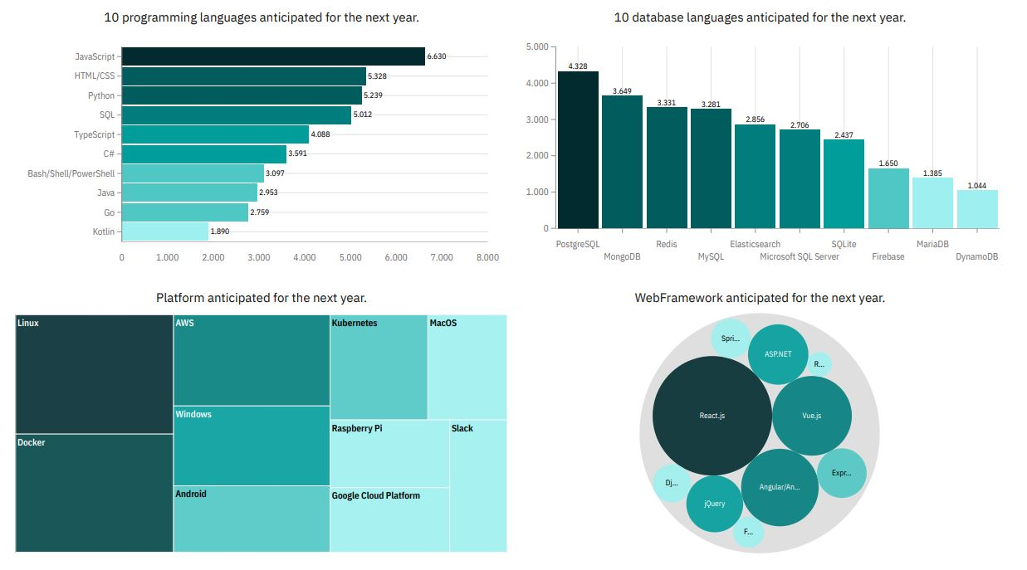
Future Technology Trend

Slide 14
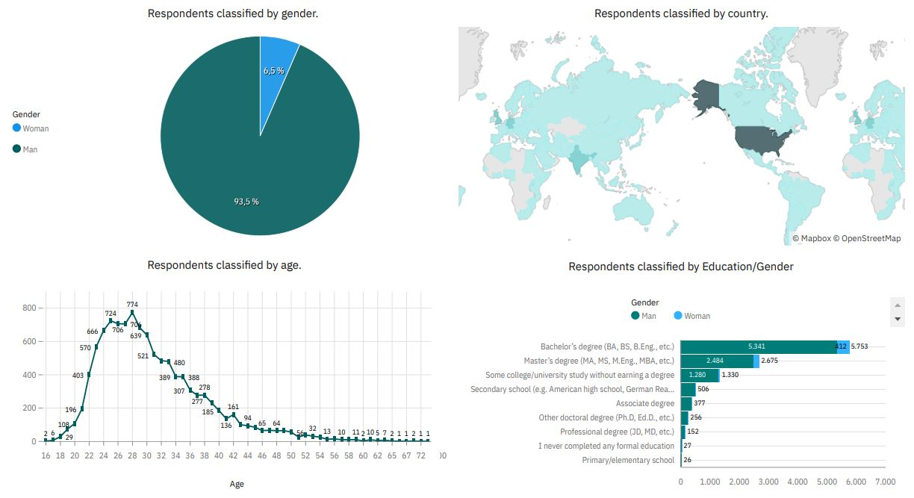
Demographics

Slide 15
Discussion
How do we identify and prioritize the technologies that aspiring developers should focus on, considering current trends and industry demand?
What strategies can we implement to bridge the gender gap in the tech industry and promote greater diversity and inclusion?
How can aspiring data analysts effectively prioritize their skill development efforts to align with the evolving demands of the industry, considering both established and emerging technologies?

Slide 16
Overall findings and implications
Findings:
Python and TypeScript will become essential due to their versatility and community support
Emerging database languages will dominate for improved performance and scalability
Foundational operating platforms will largely remain unchanged
High concentration of developers in USA and India
Implications:
Web development continues to be in high demand, making it crucial for prospective developers to consider mastering TypeScript alongside JavaScript, HTML, and CSS
In the face of rapid technological advancements, companies must remain adaptable to stay competitive
Educators and organizations have a responsibility to address not only the technological divide between countries but also to minimize the gender gap in the tech industry

Slide 17
Conclusion
To remain relevant in the technology industry, professionals must continually adapt to the rapid evolution of programming and database languages. This necessitates ongoing learning and skill development to stay ahead of emerging trends and advancements
The IT industry continues to be heavily male-dominated, emphasizing the importance of promoting gender diversity and inclusivity initiatives
Interest in programming often begins at a young age, with individuals as young as 16 showing enthusiasm for learning to code

Slide 18
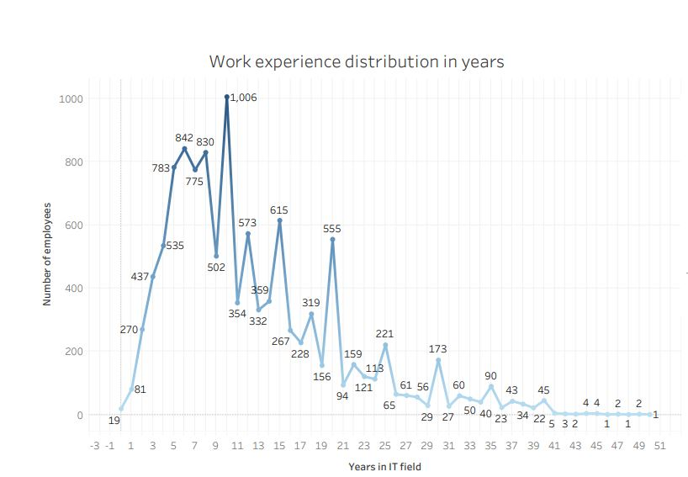
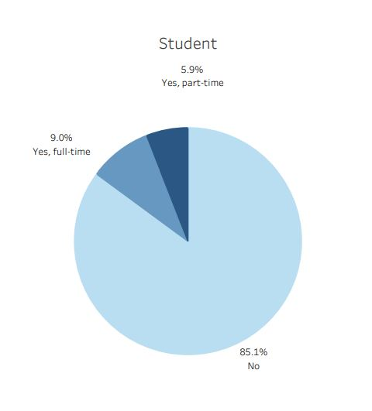
Appendix: work experience, student

Slide 19
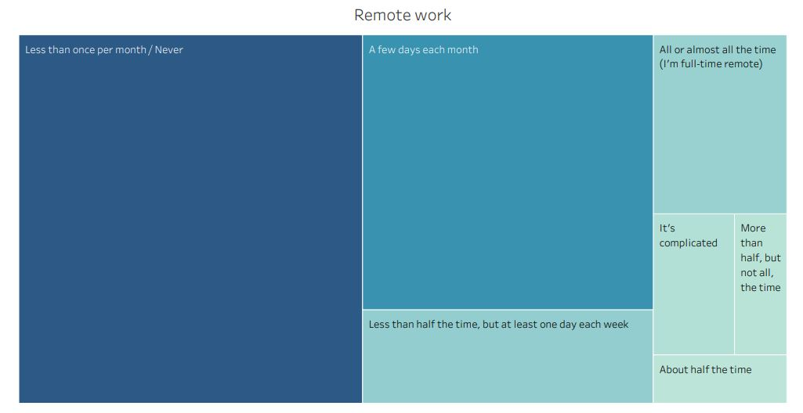
Remote work

Slide 20
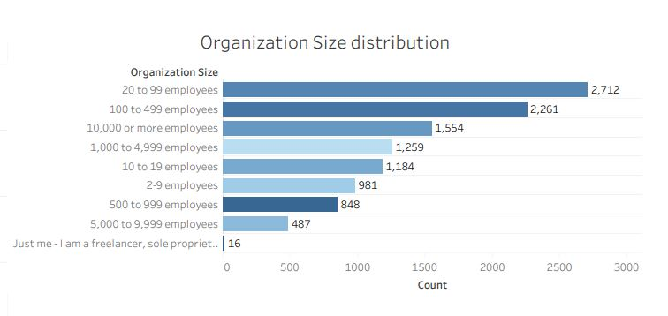
Company size

Slide 21
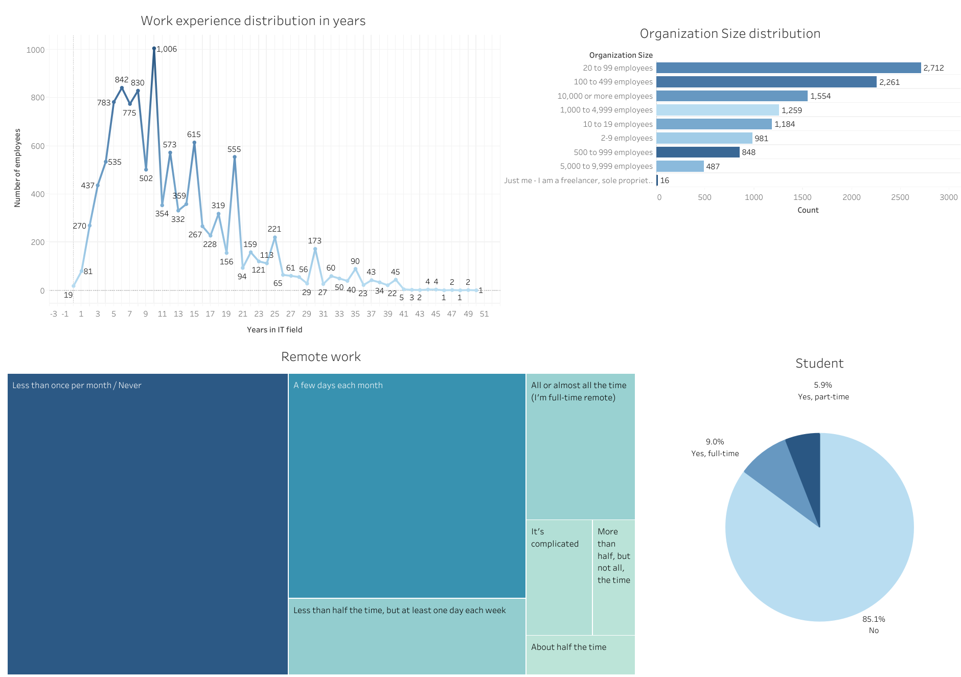
Dashboard

